Slide 1
IBAMR Tutorial - Boundary Conditions

Slide 2
Updating UNC Examples to UA, for IBAMR examples only
Go into the makefile, and change the IBAMR directories to the following:
IBAMR_SRC_DIR = /groups/lauram9/ib10/ibamr/IBAMR
IBAMR_BUILD_DIR = /groups/lauram9/ib10/ibamr/ibamr-objs-opt
**Also need to update script.sh

Slide 3

Robin boundary conditions
Robin boundary conditions are a weighted combination of Dirichlet boundary conditions and Neumann boundary conditions.
If Ω is the domain on which the given equation is to be solved and ∂Ω denotes its boundary, the Robin boundary condition is:
for some non-zero constants a and b and a given function g defined on ∂Ω .

Slide 4

Example: Robin bc’s
In one dimension, if Ω = [0,1] , the Robin boundary condition becomes:
Notice the change of sign in front of the term involving a derivative. This is because the normal at x=0 points in the negative direction, while at x=1 it points in the positive direction.

Slide 5
Example cont’d
No slip boundary conditions (Dirichlet):
a=1, b=0, g = 0 => u(0)=0, u(1) = 0
Neumann boundary conditions:
a=0, b=-1,1, g = 0 =>
-u'(0)=0
u'(1)=0

Slide 6
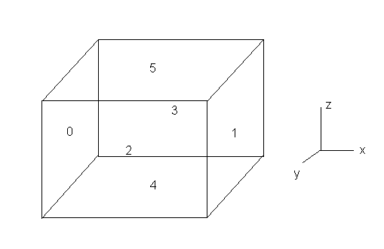
IBAMR boundary numbering
Look in the input2D/3D files.
2D: x_{left}=0, x_{right}=1, y_{bottom}=2, y_{top}=3
3D: add z_{bottom}=4, z_{top}=5

Slide 7
Choosing BC's in input2d
This would result in no slip (v=0) boundary conditions.
Note that VelocityBcCoefs_0 would set the x-component of velocity. The z-component would be 2.
VelocityBcCoefs_1 { // boundary conditions for the y-component of the velocity acoef_function_0 = "1.0"
acoef_function_1 = "1.0"
acoef_function_2 = "1.0"
acoef_function_3 = "1.0"
bcoef_function_0 = "0.0"
bcoef_function_1 = "0.0"
bcoef_function_2 = "0.0"
bcoef_function_3 = "0.0"
gcoef_function_0 = "0.0"
gcoef_function_1 = "0.0"
gcoef_function_2 = "0.0"
gcoef_function_3 = "0.0"}

Slide 8
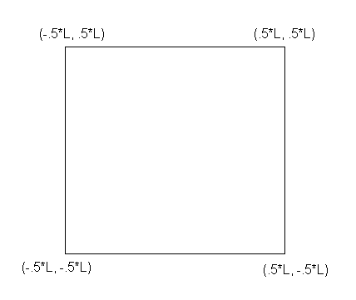
Domain size and periodic BC
Look at input2d.
x_lo sets x_{min} and y_{min}
x_up sets x_{max} and y_{max}
Periodic_dimension turns on periodic boundary conditions and overrides everything. Setting it equal to 1 means it’s on, and set to 0 is off.
CartesianGeometry {
domain_boxes = [ (0,0) , (N - 1,N - 1) ]
x_lo = -0.5*L, -0.5*L
// lower end of computational domain.
x_up = 0.5*L, 0.5*L
// upper end of computational domain.
periodic_dimension = 1, 1}

Slide 9
Example: Tethered Beam in Flow
In this example, a beam that is tethered in its center is placed in flow.
The flow is ramped from 0 to 0.1.
This is done by setting all boundary conditions equal U in the x-direction and 0 in the y-direction.
U is a function of time so that the flow accelerates from rest.
Look on github under examples
4-Example_2DTetheredBeam

Slide 10
Spatially and Time-Dependent Boundary Conditions
Look at 4-Example_2DPulsatileChannelFlow
IBAMR is capable of time-dependent and spatially dependent boundary conditions.
In ‘input2d’: under VelocityBcCoefs_0(or 1) { //
In any of the coefficients, you can use the variable ‘t’ for any time-dependence
You can use X_0, X_1, or X_2 for x,y or z respectively.
You can use inline “if-statements” for specifying boundary conditions like “if x is less than 5, then u = 2, else u = 0”

Slide 11
Notes on in-line if-statements:
Notation: if( logical statement, a, b)
-if logical statement is true, do ‘a’
-if logical statement is false, do ‘b’
Note: Can used nested in-line if-statements as well, e.g.,
if (logical statement-1, a, if( logical-statement-2, b, c) )
[if logical-statement-1 is true, do ‘a’, else if logical-statement-2 is true, do ‘b’, else do ‘c’.]

Slide 12
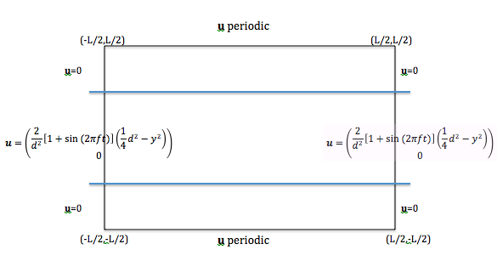
Example: Pulsatile Channel Flow
This example explores spatially and time-dependent boundary conditions for pulsatile flow through a channel.
We want to specify the boundary conditions as follows:

Slide 13
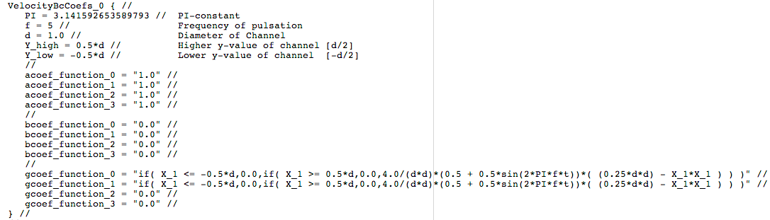
Example: Pulsatile Channel Flow
This is done by setting the appropriate x-component boundary condition on the right and left wall inside the ‘input2d’ file.
Look on github Examples under 4-Example_2DPulsatileChannelFlow

Slide 14
Part II: Changing the size of the domain, making it rectangular, etc.

Slide 15
Glycocalyx example
Look at 4-Example_3DGlycocalyx on Github.
https://github.com/fairyflies9/IBAMR-Tutorials/tree/master/Examples/UA-Examples/4-Example_3DGlycocalyx
We want to model a periodic array of (fixed) cylinders in shear flow.
Use periodic boundary conditions in two dimensions, no slip on the bottom, and prescribed velocity at the top.
The cylinder will be placed in the middle of the domain, coming out of the floor.

Slide 16
In input3d
Periodic boundary conditions in two dimensions, no slip on the bottom, and prescribed velocity at the top.
VelocityBcCoefs_0 { // boundary conditions for the x-component of the velocity
acoef_function_0 = "1.0" //
acoef_function_1 = "1.0" //
acoef_function_2 = "1.0" //
acoef_function_3 = "1.0" //
acoef_function_4 = "1.0" //
acoef_function_5 = "1.0" //
//
bcoef_function_0 = "0.0" //
bcoef_function_1 = "0.0" //
bcoef_function_2 = "0.0" //
bcoef_function_3 = "0.0" //
bcoef_function_4 = "0.0" //
bcoef_function_5 = "0.0" //
//
gcoef_function_0 = "0.0" //
gcoef_function_1 = "0.0" //
gcoef_function_2 = "0.0" //
gcoef_function_3 = "0.0" //
gcoef_function_4 = "0.0" //
gcoef_function_5 = "0.1*tanh(2*t)" //
} //
CartesianGeometry { //
domain_boxes = [ (0,0,0) , (N/8 - 1,N/8 - 1,N - 1) ]//
x_lo = -L/16, -L/16, -L/2 // lower end of computational domain.
x_up = L/16, L/16, L/2 // upper end of computational domain.
periodic_dimension = 1, 1, 0 //
} //

Slide 17
Initializing boundaries
You cannot have a boundary right on the edge of the domain initially.
Move it off the edge of the domain by ds.
In your code that generates the boundary mesh, do something like the following:
offset = -0.5*L+dq; % glyco base from bottom of domain (m)
for q = 0:npts_height-1
for s = 0:npts_circum-1
X(1) = 0.0 + glyco_radius*cos(s*2*pi/npts_circum);
X(2) = 0.0 + glyco_radius*sin(s*2*pi/npts_circum);
X(3) = offset + q*dq;
fprintf(vertex_fid, '%1.16e %1.16e %1.16e\n', X(1), X(2), X(3));
end
end

Slide 18
Making the lengths of the domain different sizes- input3d
These changes are made in the input file.
You have to think through the refinement levels to make sure that this makes sense.
In the example, the grid will have physical dimensions of ⅛ x ⅛ x 1 and a Cartesian grid that is 64 x 64 x 512.
In my example, NFINEST will denote the number of nodes on the finest grid in the longest direction.
NFINEST = 512
In the other two directions, there are NFINEST/8 = 64 nodes.

Slide 19
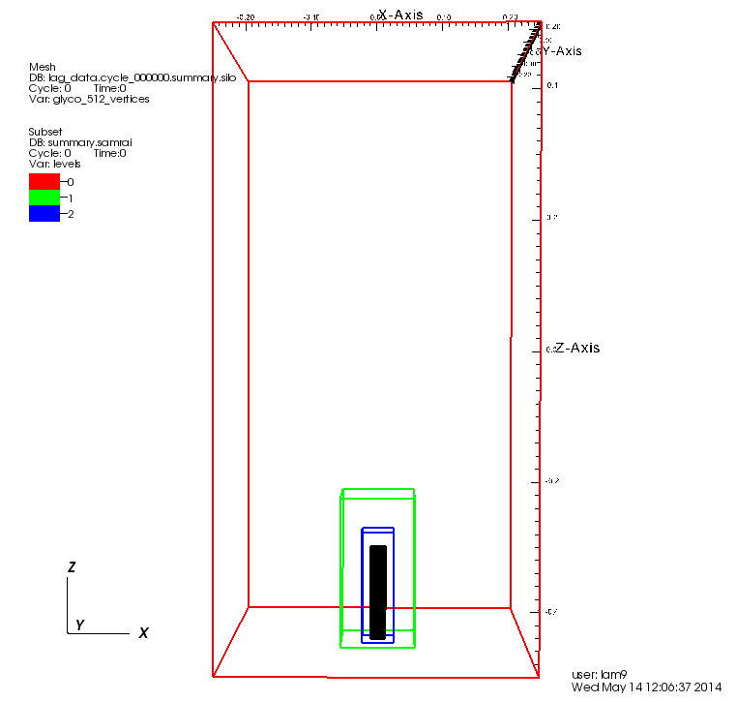
One glycocalyx cylinder

Slide 20
Levels of refinement and refinement ratio
I want to have three levels of refinement since the grid is so small in 2 directions.
The refinement ratio will be kept as 4, so that the ratio in the number of nodes on the current level and the next coarser level is 4:1.
In input3d:
MAX_LEVELS = 3 // maximum number of levels in locally refined grid
REF_RATIO = 4 // refinement ratio between levels

Slide 21
Coarsest grid
The finest level in the longest direction has 512 nodes.
There are 3 levels with a 4:1 ratio of refinement each.
This means the coarsest level in the longest direction has N = 512*(¼)^(3-1) = 32 nodes
The coarsest level in the shorter directions have N/8 = 4 nodes.
In input3D:
N = 32 // actual number of grid cells on coarsest grid in longest direction
NFINEST = (REF_RATIO^(MAX_LEVELS - 1))*N // effective number of grid cells on finest grid in the longest direction

Slide 22
AMR - Cartesian Geometry
The domain boxes should go from 0 to M-1, where M is the number of nodes on the coarsest grid in that direction.
The upper and lower physical dimensions of the computational domain should also be declared here.
CartesianGeometry { //
domain_boxes = [ (0,0,0) , (N/8 - 1,N/8 - 1,N - 1) ]//
x_lo = -L/16, -L/16, -L/2 // lower end of computational domain.
x_up = L/16, L/16, L/2 // upper end of computational domain.
periodic_dimension = 1, 1, 0 //
} //

Slide 23
Patch sizes
The largest patch size should be a cube of the finest grid that fills the domain in the shortest direction(s).
The smallest patch size should be a cube of the coarsest grid that fills the domain in the shortest directions.
largest_patch_size { //
level_0 = NFINEST/8, NFINEST/8, NFINEST/8 // largest patch allowed in hierarchy
// NOTE: all finer levels will use same values as level_0...
} //
//
smallest_patch_size { //
level_0 = 4, 4, 4 // smallest patch allowed in hierarchy
// NOTE: all finer levels will use same values as level_0...
} //

Slide 24
Summary
You need to make sure that each of the dimensions are such that they are evenly divisible by (refinement_ratio)^(number_levels-1).
Also make sure you don’t have a coarsest level of size 1 (or even 2) in any dimension.
You need to tell IBAMR how it will make the different levels of refinement. What are the bounds on the largest and smallest levels?

